Slide 1
Fourth International Conference on Online Deliberation (OD2010)
Leeds, 30 June- 2 July 2010
Participatory Frames in Deliberative Devices: the Ideal-EU case study
Julien Talpin and Laurence Monnoyer-Smith
University of Compiègne – COSTECH
CDE Research Project

Slide 2
Introduction
Broader research project financed by the French ministry of the environment, aimed at comparing the respective virtues of on-line and F2F participation
Theoretical framework: confronting Deleuze and Latour theories to the deliberative turn
Focus here on the Ideal-EU case-study
Main research questions in this paper: What is the quality of deliberation among ordinary citizens ? Is it better face-to-face or on-line ? What is the impact of the technical device on the quality of deliberation ?

Slide 3
Methodology
Direct observation of the e-town meeting
Interviews with participants and organizers
Survey submitted to all French participants
Coding and content analysis of on-line and face-to-face discussions:
  40 randomly selected on-line discussion threads (30% of total) were coded – i.e. 467 messages
  3 session of 60 minutes face-to-face discussions were coded – i.e. 167 interventions

Slide 4
Presentation outline
The Ideal-EU project: towards a European deliberation ?
The quality of on-line and face-to-face deliberation in the Ideal-EU project
Deliberating for nothing ? The limited impact of deliberation on regional and European public policies

Slide 5
I. The Ideal-EU project: towards a European deliberation ?
Project Genesis
  Funded by the European Commission
  Replication of the 21st Century Town Meeting of America Speaks.
  Topic: Climate change. Participants: Youth (14-30)
  2 deliberative devices: (1) a participatory website; (2) an e-town meeting

Slide 6
A suboptimal website design
Ideal-Eu Website Postings
Catalunia | 1,182
Poitou-Charentes | 1,161
Tuscany | 29
Other | 0
Total | 2,372
Ideal-Eu Website Users
Catalunia | 196
Poitou-Charentes | 764
Tuscany | 74
Other | 142
Total | 1,176
Little participation on-line (more in the french case)
No transnational deliberative plateform
No direct link between on-line and F2F deliberation

Slide 7
The tri-regional Electronic Town Meeting (ETM) on November 15th, 2008
3 sites: Poitiers, Florence, Barcelona – 500 participants
Diverse (not representative) sample of voluntary participants (between 14 and 30 y.o.) recruited through an intense outreach campaign
Designed to foster deliberation: small tables of 10 participants and a facilitator
Participants’ opinions synthesized by a theme team, and displayed on a big screen in each Region
Electronic ballots in response to 5 or 6 preset questions; outcomes given in real time
Summaries and poll results → 50-page report to MEP Guido Sacconi

Slide 8
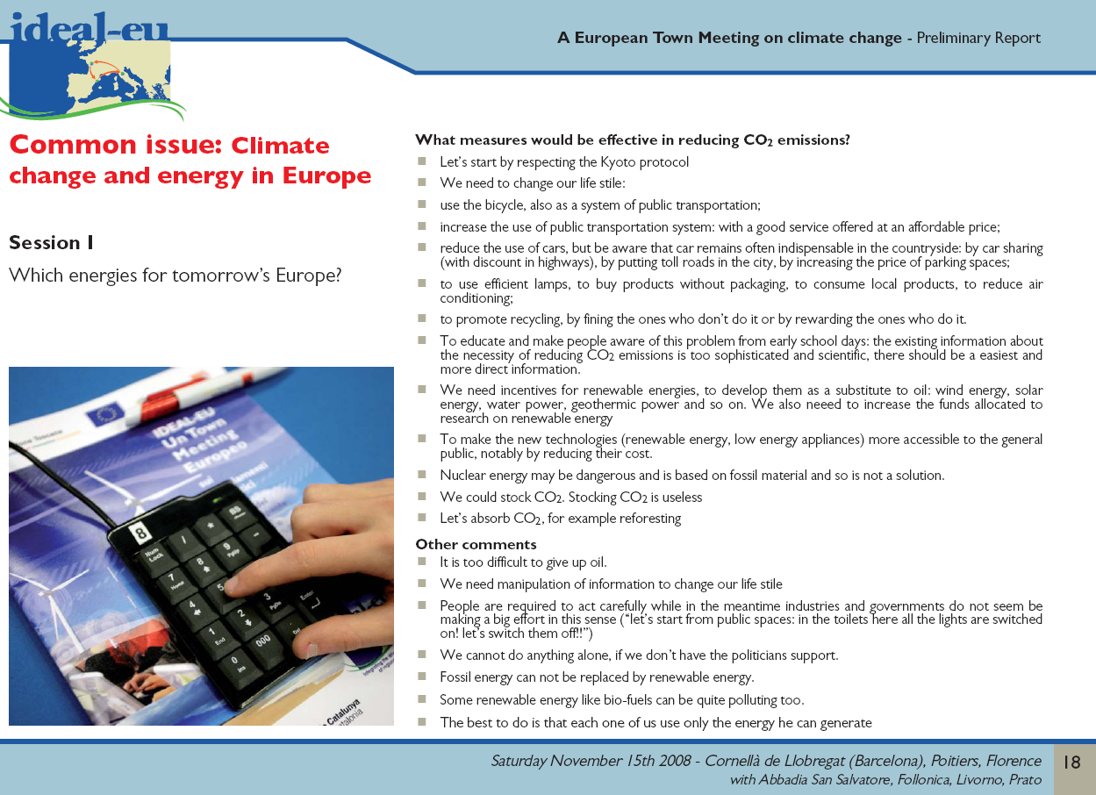
Summary of a discussion displayed on the big screen – and voting keypad

Slide 9
II. The quality of on-line and face-to-face deliberation in the Ideal-EU project
Systematic comparison of on-line and face-to-face discussions. Coding and content analysis
4 criteria (partly inspired by Steiner et al. 2004; Jansen, Kies, 2004; Stromer-Galley 2007):
(1) inclusiveness; (2) reciprocity; (3) level of justification and politicization of the arguments; (4) level of information and reliability of claims
Impact of the discussion format (on-line vs. Face-to-face) or of the discussion frame (local vs. Global) on deliberative interactions ?

Slide 10
(a) Discursive inclusion
Table 4. Use of personal experience and general justifications
More justifications online and few personal ones
Framing of the discussion appears the most important factor when it comes to discursive inclusiveness
 | No justification | Personal experience | General justification
On-line | 28 | 9,2 | 67,6
Face-to-face | 49,1 | 10,2 | 45,5
Local frame | 41.6 | 17,8 | 46.5
Global frame | 39.6 | 7,8 | 57

Slide 11
(b) Reciprocity: Little disagreement, but more on-line than face-to-face
The rule is consensus: about 60% of « neither »
A bit more disagreement expressed on-line and more sophisticated (yes, but) arguments
 | Agreement | Disagree-ment | Neither | Both | Breaking off
On-line | 16,4 | 12,3 | 54 | 11,8 | 5,5
Face-to-face | 13,8 | 12,6 | 61,1 | 4,2 | 8,4
Local frame | 17,8 | 4 | 66,3 | 4 | 7,9
Global frame | 13,6 | 14,1 | 58,1 | 7,5 | 6,7

Slide 12
(c) Level of justification
High frequency of general justifications
No reference to self-interest and partisan politics (while over-representation of participants interested in politics)
Impact of the frame on the politicization of the discussion
 | Politicized interventions | Unpoliticized interventions
On-line | 26,3 | 73,7
Face-to-face | 32,9 | 67,1
Local frame | 16,8 | 83,2
Global frame | 30,6 | 69,4

Slide 13
(d) Level of information and reliability of claims
 | On-line | ETM | Local frame | Global frame
Factual elements | 33.3 | 3,6 | 27,7 | 26,8
Authorities | 6,1 | 4,2 | 3 | 4,8
Other participant | 19,5 | 3,6 | 11,9 | 10,7
External sources | 10,1 | 3,6 | 5 | 7,1
Not precise | 78.6 | 91,6 | 85,1 | 85,3
Vague quotation | 14,2 | 7,8 | 9,9 | 10,4
Precise sourcing | 7,2 | 0,6 | 5 | 4,3
Discussions more constructive (not monological) on-line – as evidenced by references to other participants
Discussions more informed on-line

Slide 14
A good deliberation … at the national (not European) level
Discussions were inclusive, oriented towards the common good, informed and responsive.
Local framings foster the enlargement of discursive modes beyond argumentation (expression of personal stories and emotional discourses), they also tend to depoliticize the discussion.
On-line discussions foster constructive and informed deliberation, they do not enlarge the range of possible arguments, and fail to be more (discursively) inclusive than face-to-face deliberation.
Failure to foster a European deliberation. No cross-country deliberation, only “European” polling.
Notes:
One of the conclusions could therefore be that these different format – on-line and face-to-face, local and global framings – should indeed be associated and articulated during deliberation, as did the Ideal-EU project, in order to fulfil the entire potential of deliberative democracy.
Deliberations of good quality took place, but among national citizens. On-line participants discussed in their language among their fellow citizens. Face-to-face, the national discussions were intermingled with a few discussions through video-conference between the three countries animators of the town-meetings, and a synchronous translation was provided, indicating the European nature of the experience. But participants of the three countries did not talk, and even less argue, among each other. The only “European” or supra-national component in the Ideal-Eu experiment was the voting system. The same polling questions were asked to all three regions' participants, and their answers were aggregated in the final document, transmitted to the European parliament. This leads to the question of the (limited) impact of thus experiment, on both public policies, and more broadly on the European public sphere.

Slide 15
III. Deliberating for nothing ? The limited impact of deliberation on regional and European public policies
Elected officials commitment: A Transparent « Cheery-picking »
The importance of external impact for participants
42.9% of ETM participants declared they attended to “influence decisions”
But no impact on regional and European public policies 1.5 year later
Deliberation and Decision: Screening proposals and emphasizing opinions
Lack of political support
Notes:
G. Stupar, Regional Councilor – closing statement of the ETM:
“Your suggestions will indeed be taken into account, not just by the European Union, but by our Regional Council. I invite you to check our website to see how and when your suggestions are taken into account.”
Guid Sacconi, MEP, President of the Temporary Commission on Climate Change of the Euro-Parliament (when he received the report – november 18th, 2008)
“To respond immediately to your expectations, know that I shall circulate your final report to all Euro-parliamentarians, with of course, special emphasis on members of the Temporary Committee on Climate Change. We shall review your proposals carefully. In addition, we shall send copies to other partner Regions, so that they can pass on to you a summary of the all the climate change laws that will highlight your input and the provisions that incorporate your proposals.”
“As a participating youth, and in the name of everyone I know who took part in Ideal-EU on November 15th – and even everybody I didn’t meet too, I think – I would like to see how the proposals we made and put into this final report will become a reality. I’d like to see how they become incorporated into the legislation pending with the European Parliament and if we actually made any real contribution to change.”
”My expectations about positive, visible results from the suggestions we have made to the Euro-parliamentarians…My expectations about what happens next are the same as that of the other participants: we want to see our proposals in future draft legislation and, more importantly, in policy measures over the years to come.”
Different discourses in different contexts – G. Sacconi:
“So, it was quite an experience, right? But, um, uh, about impact, I’m not sure if anybody has thought about follow-up. It was sort of, let’s say, a special experiment…Of course, expressing an opinion about policy choices, E.U. directives and regulations (is always complicated). Personally, I think it’s the decision-makers – elected representatives – they’re the ones who should decide. It’s up to them to make the final call. It’s their job to make the final summary (of your input).”
“Yes, I think it had a slight effect, in the way we underscored the long-term nature of local programs and inclusion of the citizenry. In that way, yes. But on specific policy choices, um, uh… The fight against climate change is complex issue.”
Reports contained two type of information :
Synthesis of comments (cf. above) – too general to have any impact
Eg. “use bicycles” ; “expand public transport” ; “reabsorb C0₂ through reforestation.”
Poll results : just like an opinion poll

Slide 16
Conclusion
Good deliberative quality
Failure to foster a European deliberation
No impact on public policies
Deliberating for what ? Improved competence and cynicism. The risks of democratic experimentalism

