Slide 1
Mixed initiative argument in public deliberation

Slide 2
The link between argument1 and argument2
create
update
Using debate to navigate argument resources
replay
play with
Mixed initiative argumentation
- new debates with old arguments
- different automation strategies
- KE on the QT
Engaging public engagement
- dialogue structure, not NL, for naturalness
- breaking down the barriers between the official
(the broadcast; the formal) and the public (the
consultative; the informal)

Slide 3
Domain Background
Beauly – Denny Power Line

Slide 4
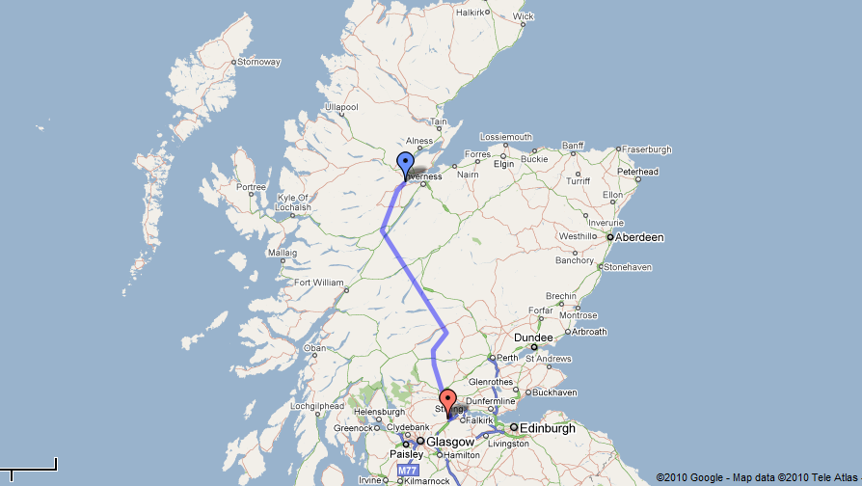
Beauly – Denny Power Line

Slide 5
Argument Analysis
OVA - Online Visualisation of Argument

Slide 6
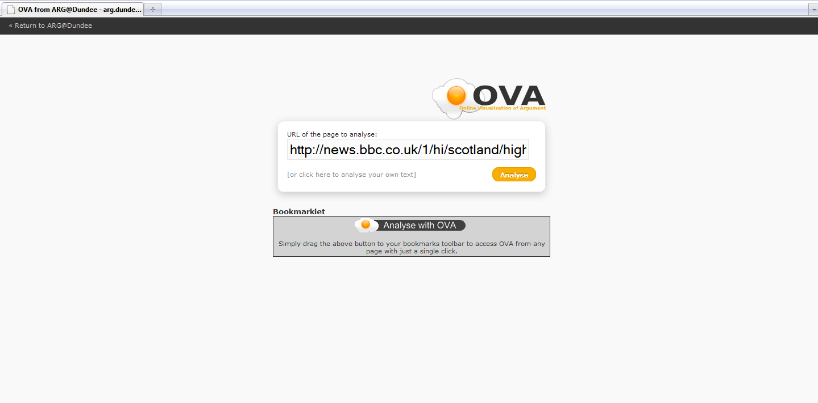
OVA: start page

Slide 7
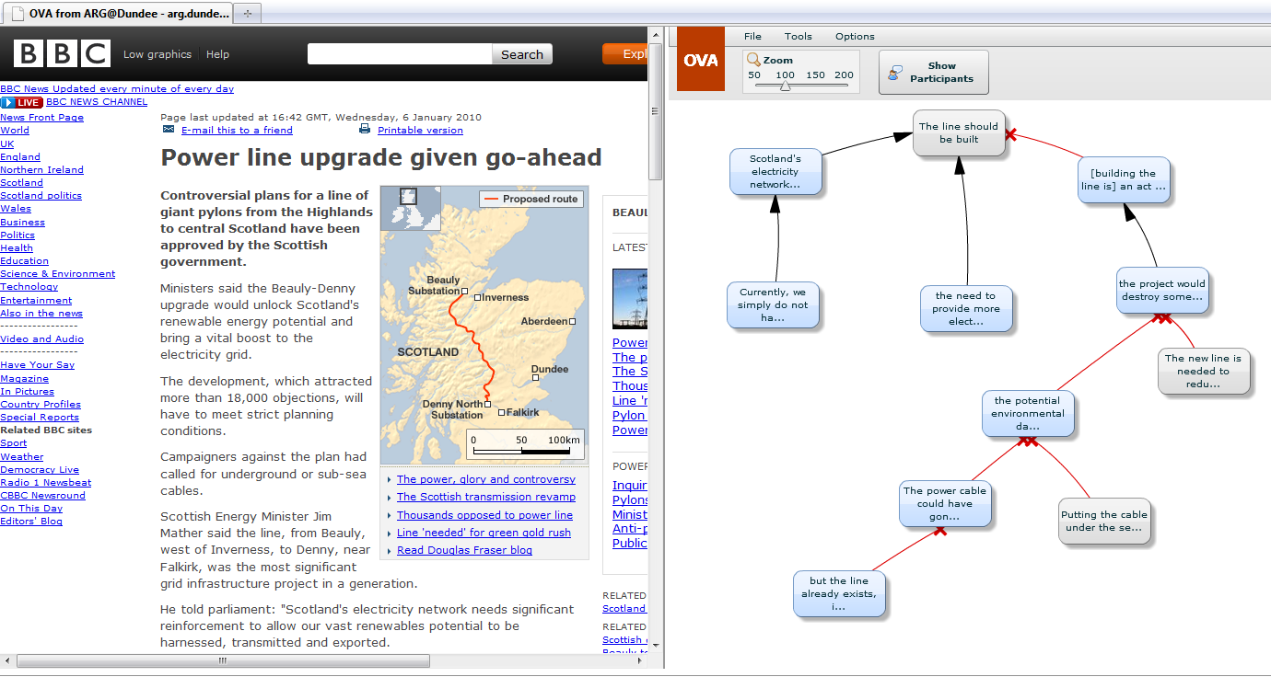
OVA: user interface

Slide 8
OVA: analysis

Slide 9
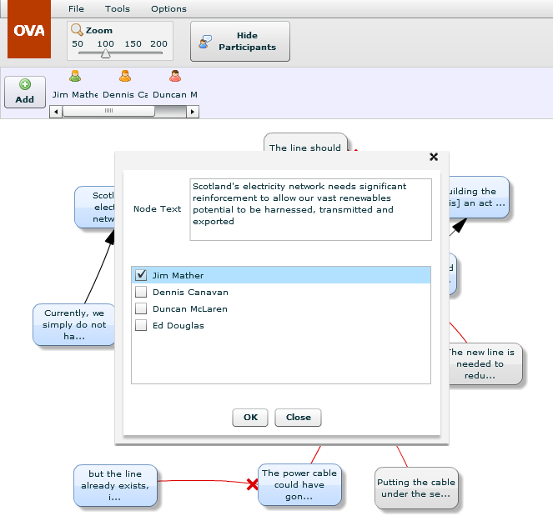
OVA: adding participants

Slide 10
Interchange
AIFDB & OVAView

Slide 11
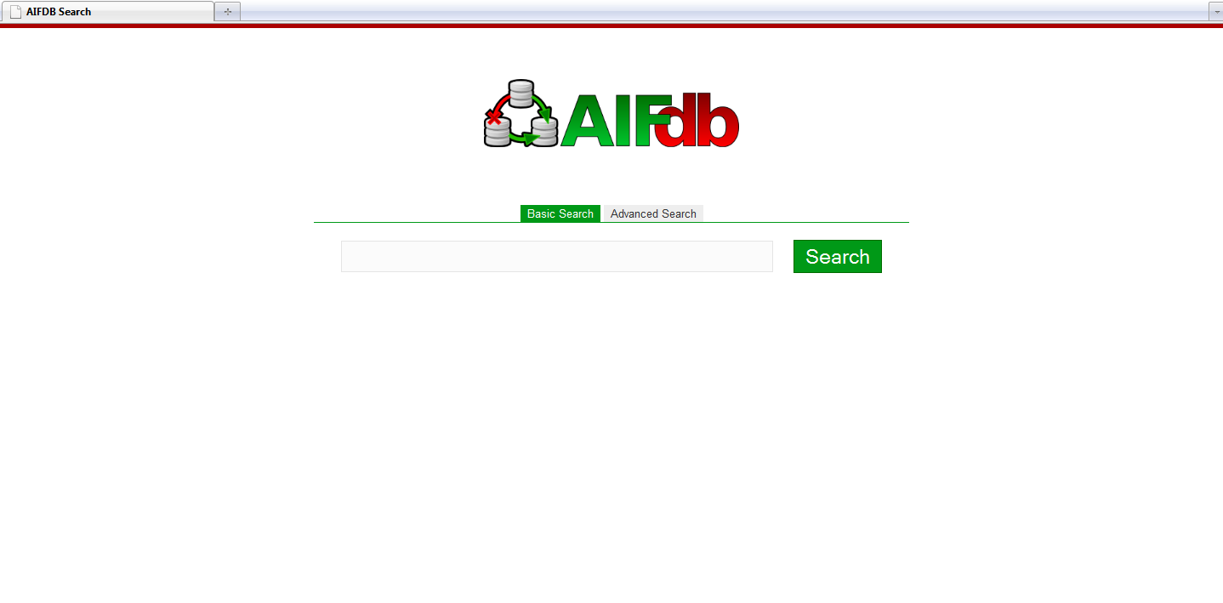
AIFDB

Slide 12
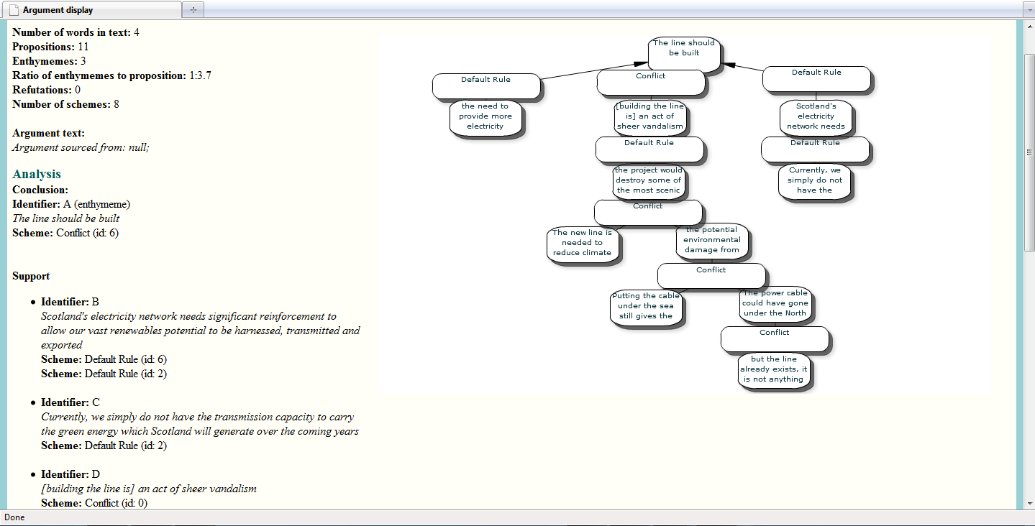
OVAView

Slide 13
Argument Interaction
Arvina

Slide 14
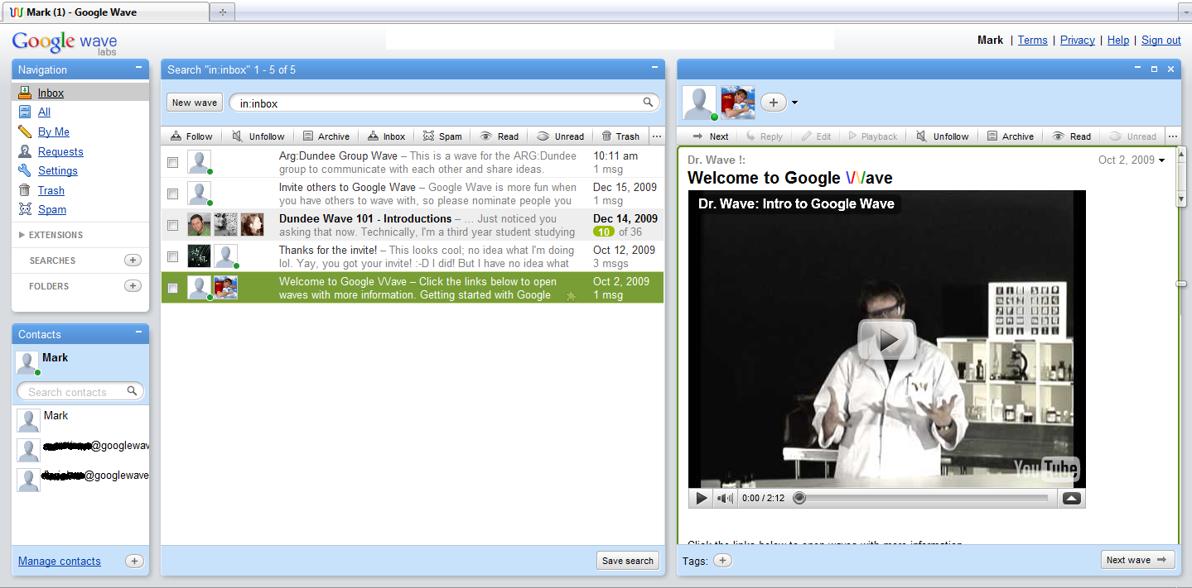
Arvina: Google Wave
http://wave.google.com

Slide 15
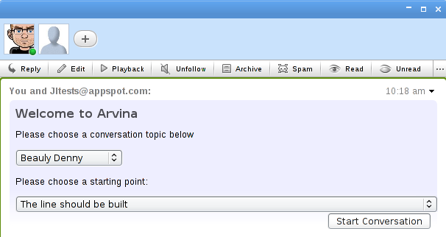
Arvina: starting a conversation

Slide 16
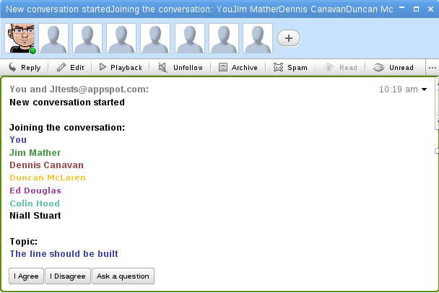
Arvina: virtual participants

Slide 17
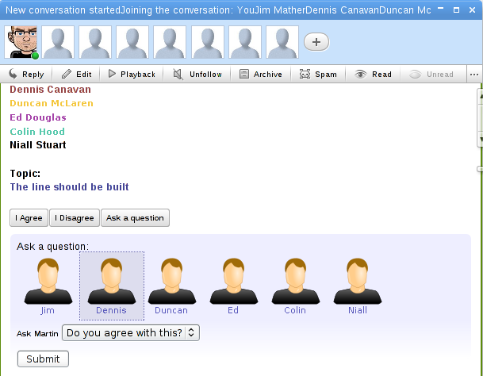
Arvina: asking a question

Slide 18
Arvina: Mixed Initiative Argument Dialogues

Slide 19
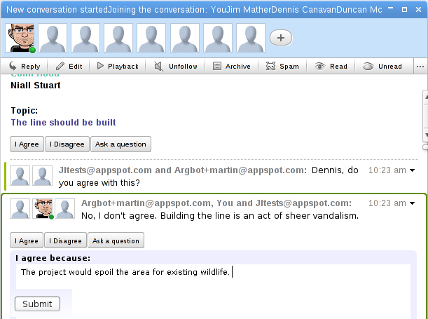
Arvina: eliciting further knowledge

Slide 20
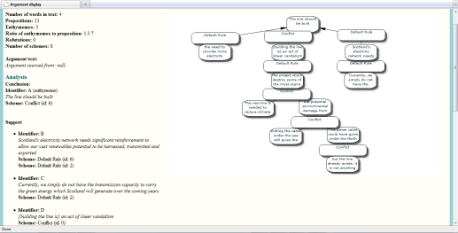
ArguBlogging
AIFDB
Argument
Microblogging

Slide 21
Summary & Conclusions

