Slide 1
Mapping the Practice of Online Deliberation
Edith Manosevitch, PhD
Emek Yezreel Academic College, Israel
The Fourth International Conference on Online Deliberation,
Leeds University Business School, Leeds, UK.

Slide 2
Acknowledgement
This research is a product of a Joint Learning Agreement with the Kettering Foundation, Dayton Ohio, USA.

Slide 3
The Role of Design in Public Deliberation
Design matters for the quality of online talk (Coleman, 2004; Janssen & Kies, 2004; Wright & Street, 2007)
“The democratic possibilities opened up (or closed off) by websites are not a product of the technology as such, but of the ways in which it is constructed, by the way it is designed.” (Wright & Street, 2007, p. 850).
Examples: A-synchronic, identification, moderation.

Slide 4
Implication of Design on Deliberative Theory of Democracy
Analysis of mini publics (Fung, 2003)
Great variation in endeavors of public deliberation
Design of deliberation determines:
Who participates
What topics are discussed
Possible outcomes
Put another way:
Design reflects a particular understanding of the deliberative theory of democracy.

Slide 5
Varying Conceptions of Deliberation Theory
For example:
Goal:
Informed citizenry (Zaller, 1994; Ryfe, 2002)
Informed public opinion (Fishkin, 1995)
Engaging citizens in the creation of public policy (Biaocchi, 2001; 2004).
Role of citizens:
Providing informed public opinion (Fishkin, 2005)
Working through issues together (Mathews, 1999).

Slide 6
Research Goal
Mapping the practice of online deliberation in terms of the underlying theory of democracy.
RQ: What is the concept of deliberation that is conveyed by current endeavors of online deliberation?

Slide 7
Driving Hypothesis
Varying design choices reflect varying conceptions of deliberative democracy, specifically:
Goal of public deliberation
Role of citizens and institutions in the process
Nature of public deliberation.
Justification: Identifying the theory of democracy underlying online deliberation could help illuminate the possibilities of current practice, and directions for development.

Slide 8
Research Design

Slide 9
Online Deliberation Websites Definition
Spaces of discussion that are hosted on the web and have been created for the purpose of fostering deliberative public discussion about public issues. (Builds on Janssen & Kies , 2005)

Slide 10
Sample
Snowball sample, 13 websites
Criteria:
Primary and explicit purpose is to engage citizens in public discussion of issues
Not confined to a particular issue, community or geographical location
Not included: Blogs, or discussion forums appearing as a by-products on a websites

Slide 11
Sample Websites
America Speaks
Viewpoint Learning
E-the people
E-Democracy
Do Tank
Web Lab
Dialogue Circles
Truth Mapping
Open-Space Online
By the People
DroppingKnowledge
OnlineGroups
Soliya

Slide 12
Method
October 2008 – May 2009 (recently updated)
Content analysis:
About page:
Mission statement and declared goals
Guidelines provided on the websites:
Goals of deliberation/forums
Guidelines /rules for online forums
* Not examined: content of specific forums

Slide 13
Findings

Slide 14
Distinction 1: Role of the Website
Host websites
Provide space, tools and guidance needed for deliberation.
Enable the process, encourage and support it,
Do not initiate or convene deliberation.
Do not take any active part in the actual deliberation.
Convener Websites
Provide space, tools and guidance needed for deliberation.
Initiate and convene deliberation.
Take the leading role in the process.
Enable the process, make deliberation happen.

Slide 15
Distinction 2: Goal of the Website
Democracy Driven
Driven primarily by ideals of the deliberative theory of democracy.
Usually run by non-profit and/or foundation-based organizations.
Seek to strengthen democratic life by promoting constructive public discourse.
Service Providers
Provide online deliberation as a service.
Mostly for-profit private organizations.
Collaborate with democracy-driven organizations (or offer their services) to implement deliberation.

Slide 16
Table 1: Primary role of website by primary goal
Convener | Host | Website type
America Speaks Viewpoint Learning BythePeople Soliya | E-Democracy e-thePeople DemocracyLab Truth Mapping droppingknowledge | Democracy Driven
Ascentum WebLab | OpenSpaceOnline Online groups.net | Service Provider

Slide 17
What is the underlying theory of deliberative democracy in each type of website?

Slide 18
Host Websites Citizen-Centered Approach
Informed citizenry Informed public opinion, working strengthening communities and working through issues together | Goals (vary)
Initiators, and drivers of the process | Role of Citizens
Provide online space, tools & guidance Encourage and support Do not initiate, participate or lead | Role of Institutions
Organic, evolving | Nature of the process

Slide 19
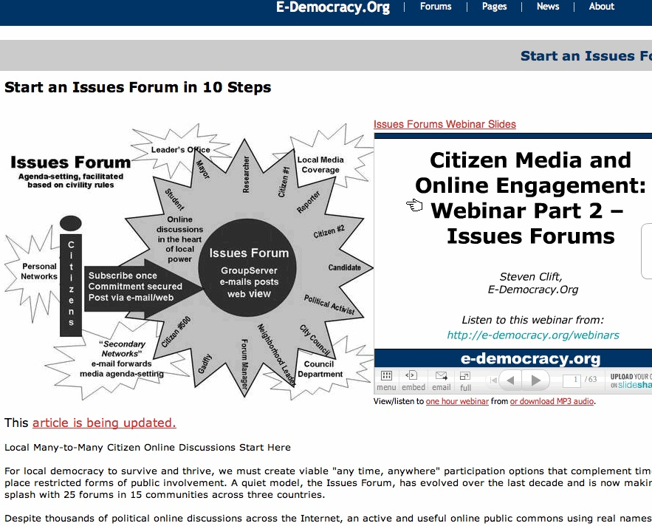
Example: E-Democracy.org

Slide 20
Convener Websites Institution-Centered Approach
Informed citizenry Informed public opinion to be used by policy makers | Goals
Participant in the deliberative process Contributors to naming and framing the issue | Role of Citizens
Initiators and drivers of the process Provide online space, tools & guidance Encourage and support | Role of Institutions
Planned and structured Usually define and select issue topics | Nature of the process

Slide 21
Example: Listening to the City Implemented by America Speaks

Slide 22
Table 2: Primary goal of online deliberation
Convener | Host | Primary goal
Soliya | droppingknowledge | Education
 | TruthMapping E-the People E-Democracy | Informed public discussion
 | DemocracyLab E-Democracy | Working through local issues
By the People |  | Informed public opinion
America Speaks Viewpoint Learning OpenSpaceOnline OnlineGroups |  | Affecting public policy

Slide 23
Table 3: Role of Citizens and Institutions
Convener | Host | Driver of the process
 | E-Democracy E-the People DemocracyLab TruthMapping Dropping knowledge OpenSpaceOnline OnlineGroups | Citizens
AmericaSpeaks ViewPoint Learning Soliya Bythe People Ascentum WebLab |  | Institutions

Slide 24
Table 4: Nature of the deliberation process
Conveners | Hosts | Nature of Process
 | E-Democracy E-the People DemocracyLab TruthMapping Dropping knowledge OpenSpaceOnline OnlineGroups | Organic
AmericaSpeaks ViewPoint Learning Soliya Ascentum WebLab BythePeople |  | Structured and Planned

Slide 25
Summary of Results
Convener Websites Institution-Centered Approach | Host Websites Citizen-Centered Approach
Pragmatic: Informed citizenry and/or public opinion for policy-makers | Full spectrum: from informed citizenry to working through issues | Goals
Participants, providers of informed public opinion, contributors to policy making. | Initiators & drivers of the process | Role of Citizens
Initiators drivers of the process | Provide tools , guidance and support. Do not initiate, or participate | Role of Institutions
Planned and structured | Organic, evolving | Nature of the process

Slide 26
Limitations
Sample size and scope
Content analysis

Slide 27
Discussion
Host and Conveners: Each type effective for different goals
Hosts:
Empower citizens for raising issues; working together through issues
Bottom-up process, enables the creation of an authentic public voice
Limitation: limited resources may impede upon effective engagement
Conveners:
Structure and planning is effective
Public voice is limited: but it is heard!
May help promote political orientations: interest, knowledge, efficacy.
Implications for the practice of online deliberation

Slide 28
Thank you!

